Slide 1
2017 Seniors
New Lexington FFA

Slide 2
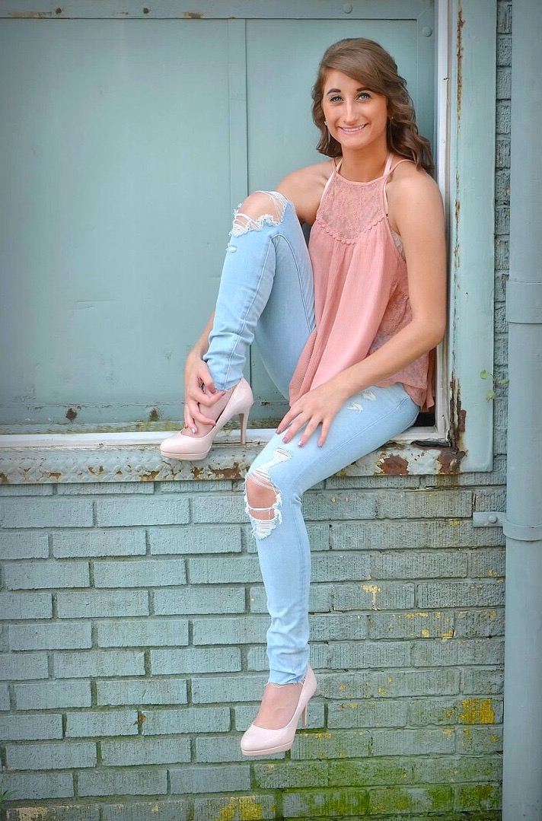
Teyler Alfman
Zane State
Nursing

Slide 3
Alicia Altier

Slide 4
Lucas Barnett

Slide 5
Caleb Barnette

Slide 6
Dalton Barnette

Slide 7
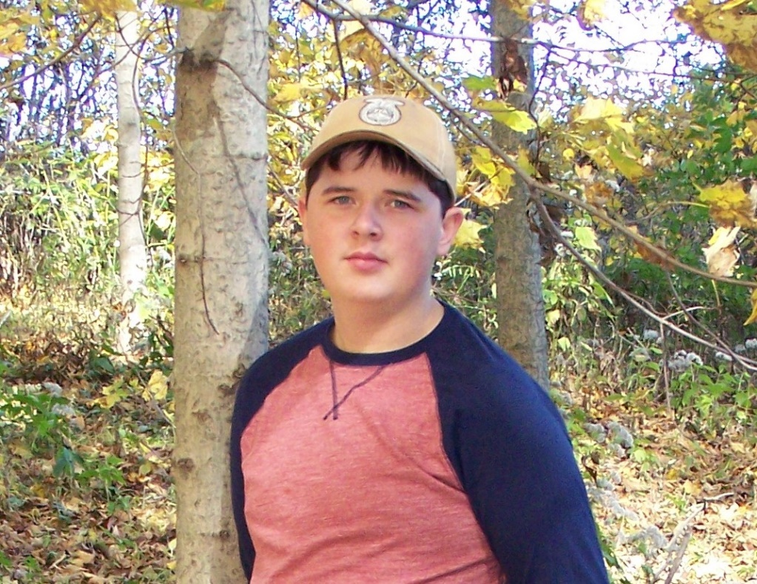
Dakota Brame
The Ohio State Universtiy –ATI
Agriculture Education

Slide 8
Tyler Brown

Slide 9
Briana Brunton Ohio University Nursing

Slide 10
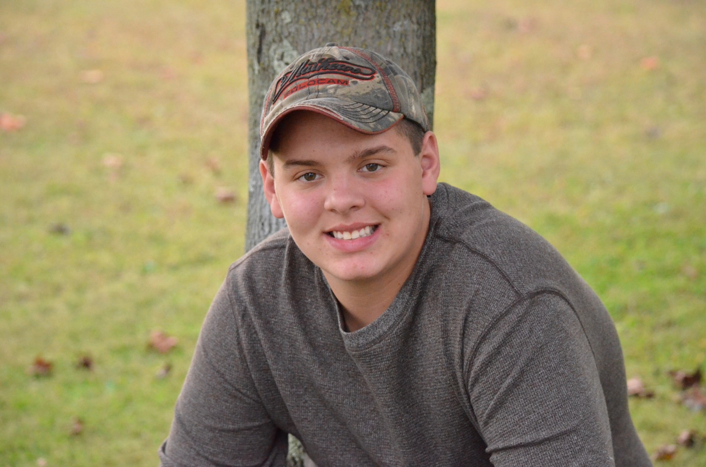
Blake Burdette
Mid-East Career Center
Welding

Slide 11
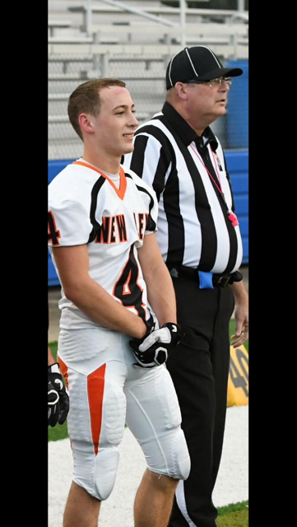
Dalton Burton
Capital University
Pre-Physical Therapy

Slide 12
Dalton Chapman
Ohio National Guard

Slide 13
Bradley Clapper

Slide 14
Justis Coyle

Slide 15
Janzan Cozad

Slide 16
Malia Dunn University of Akron Field of Medicine

Slide 17
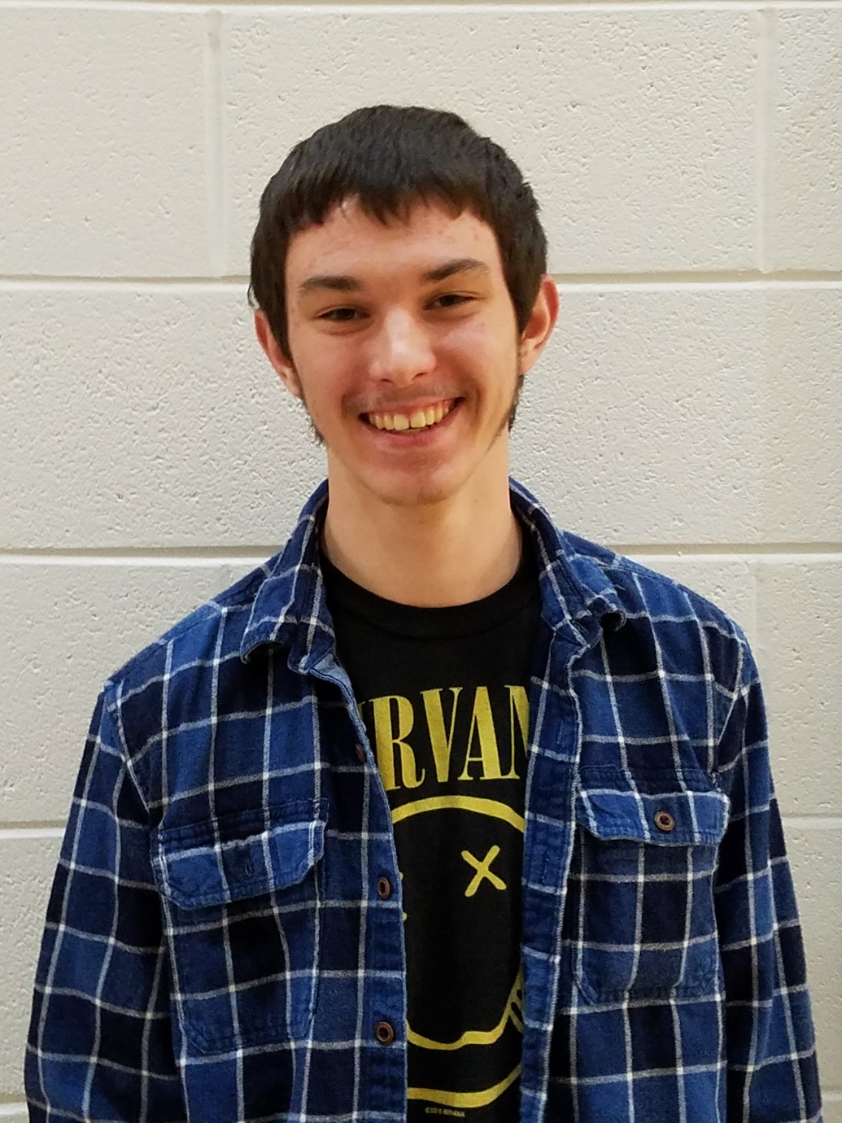
Alec Elliott
The Ohio State University – Mansfield
Early Childhood Education

Slide 18
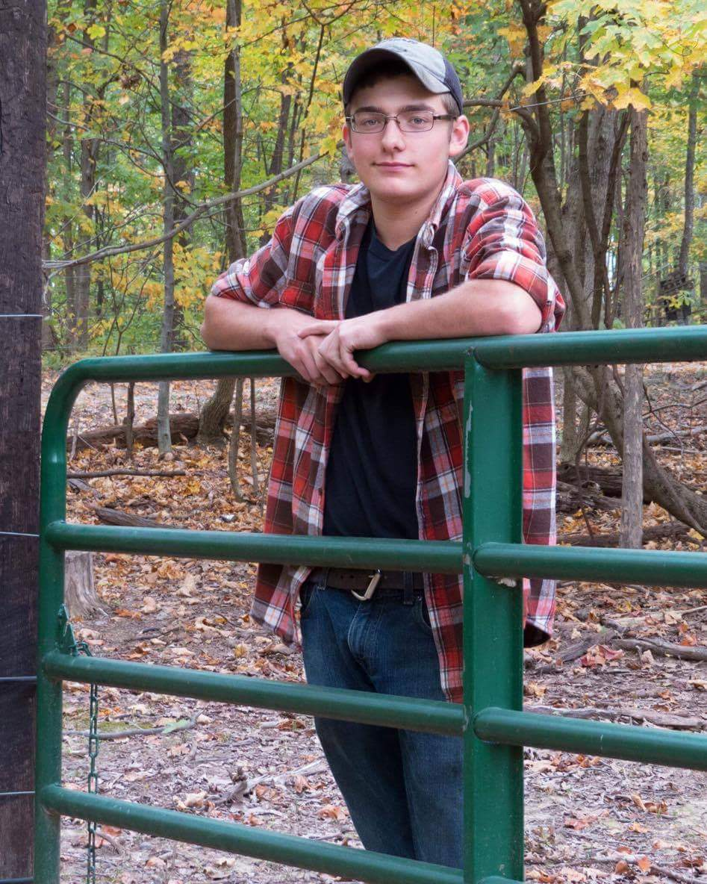
Hunter Embrey
Mid-East Career Center
Welding

Slide 19
Mitchell Ervin
Hocking College
Geo Environmental Science

Slide 20
Leah Forson

Slide 21
Justin Dale (JD) Garey Peak Trucking & Excavating

Slide 22
Clayton Glick

Slide 23
Nathan Gordon
Wright State University
Mechanical Engineering

Slide 24
Alyssa Hall

Slide 25
Braeden Hammer

Slide 26
Brent Hermey

Slide 27
Tyler Hicks

Slide 28
Garrett Hoops

Slide 29
Jacob Hughes

Slide 30
Kaige Jones

Slide 31
Tray Kirk

Slide 32
Devin Knecht

Slide 33
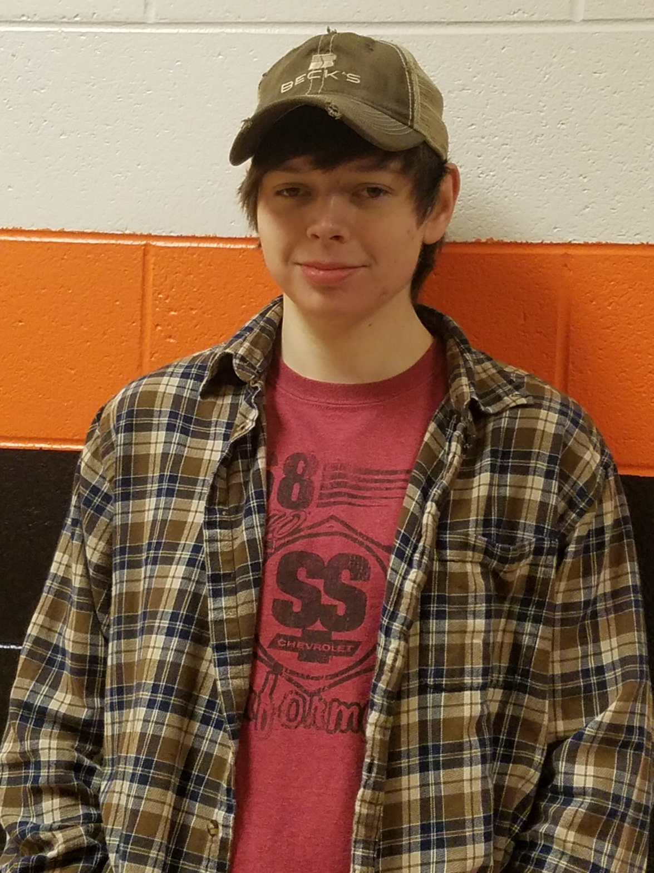
Michael Lucas
Anchor Hocking

Slide 34
Chris Lutz

Slide 35
Hope Lutz COTC –Newark Ultrasound Technology

Slide 36
William Maynard

Slide 37
Brayden Metzger Southeast Lineman Training Center Lineman

Slide 38
COTC Mechanics Certificate Jordan Middaugh

Slide 39
Gage Morgan

Slide 40
Bailey Novaria Kent State Fashion Merchendising

Slide 41
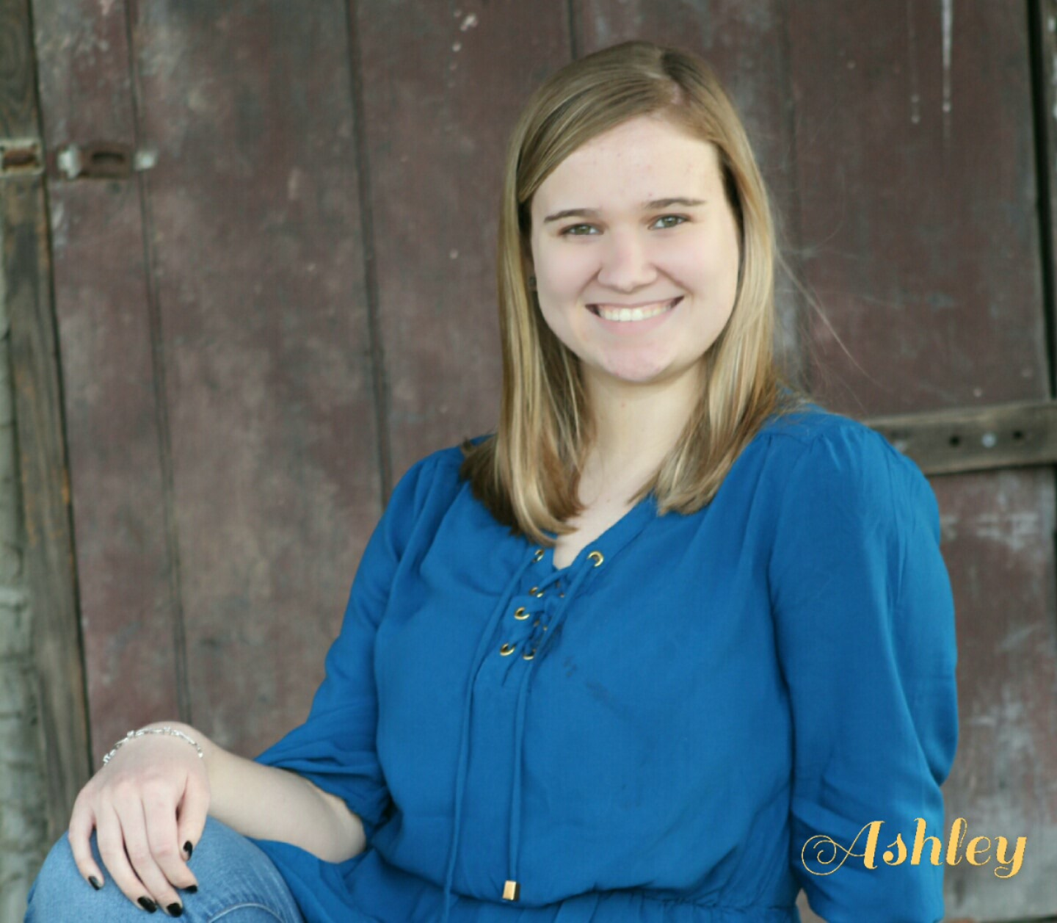
Ashley Nutter
Ohio Northern
Forensic Biology

Slide 42
Hunter Rose

Slide 43
Austin Scott

Slide 44
Brett Scott

Slide 45
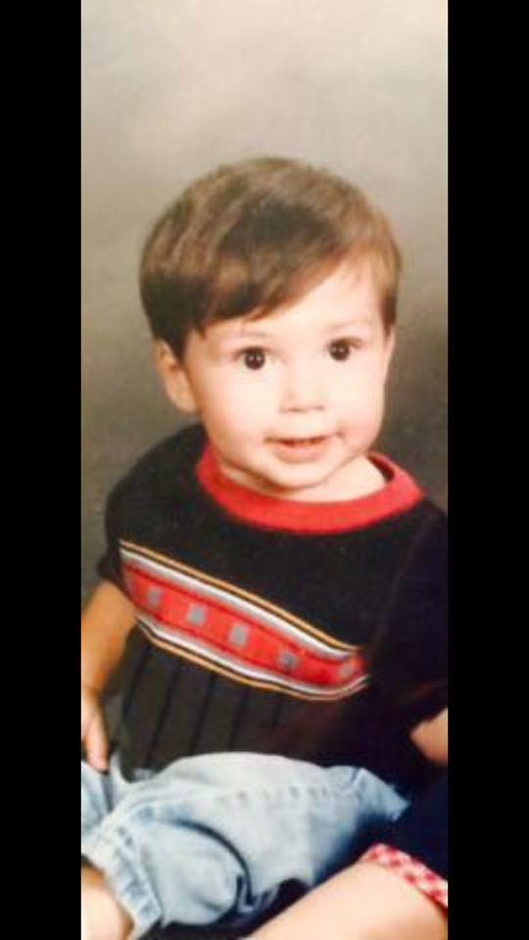
Chase Sheppard
United States Navy

Slide 46
Jacob Sheppard

Slide 47
Kacey Shipley
Hocking College
Physical Therapy Assistant

Slide 48
Zach Sidwell

Slide 49
Rose Spangler

Slide 50
Taylor Starlin Ohio State School of Cosmetology

Slide 51
Greg Thomas

Slide 52
Olivia Tittle

Slide 53
Derek Valentine

Slide 54
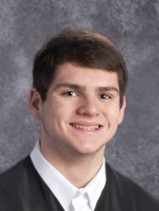
Antonio Villaloboz
The Ohio State University-Newark
Nursing

Slide 55
William Vining-Perrin

Slide 56
Wade Ward Workforce

Slide 57
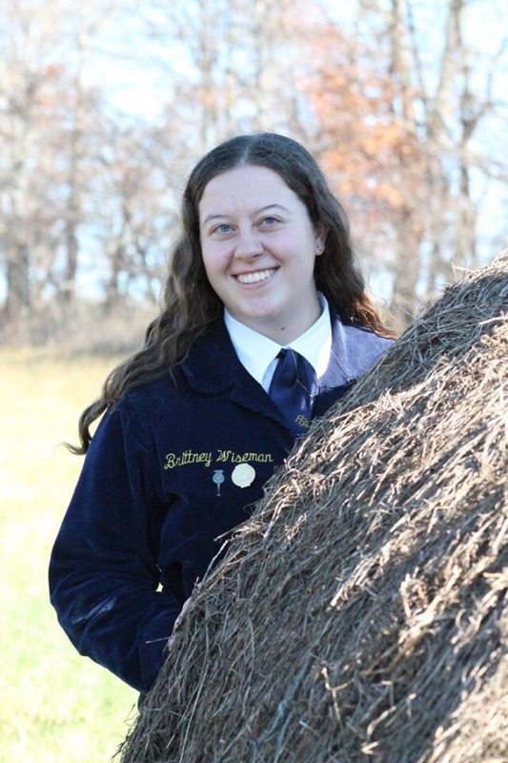
Brittney Wiseman
The Ohio State University – ATI
Meat Science & Technology

Slide 58
Jared Wycinski

